Slide 1
TaCare Project

Slide 2
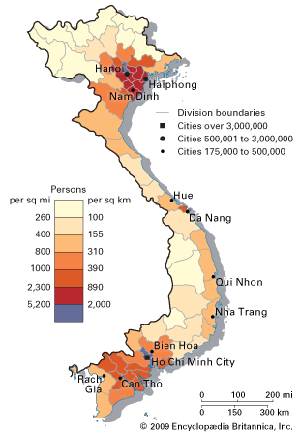


90,000,000
1/2 of population
Knowledge of first-aid in case of emergency
Reliable information about diseases and treatments

Slide 3


Slide 4


Slide 5
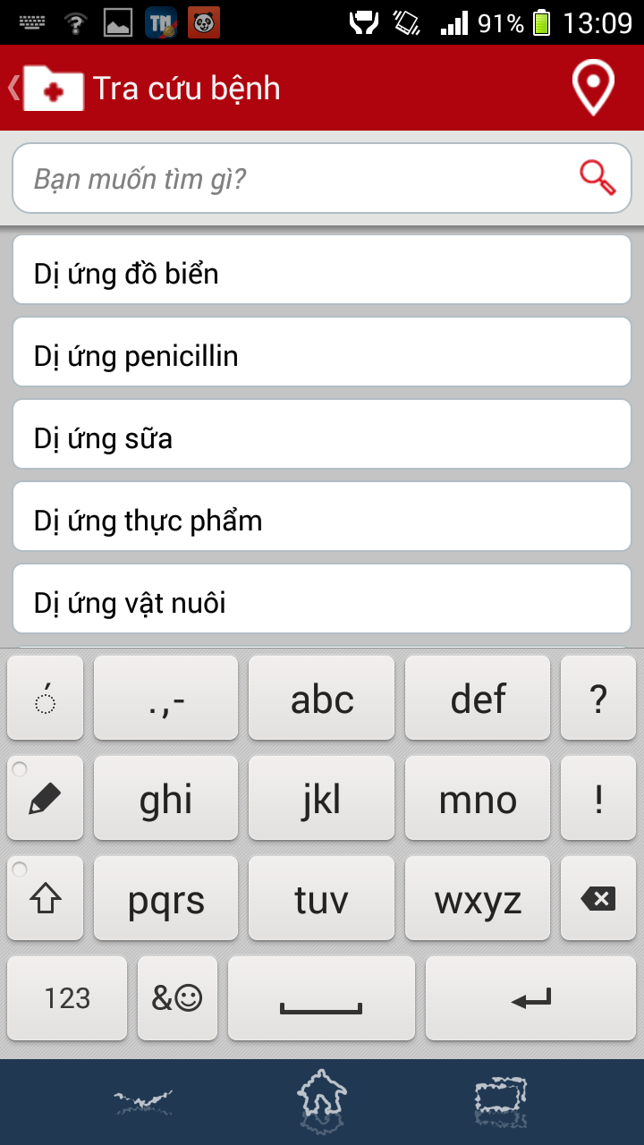

Slide 6


Slide 7
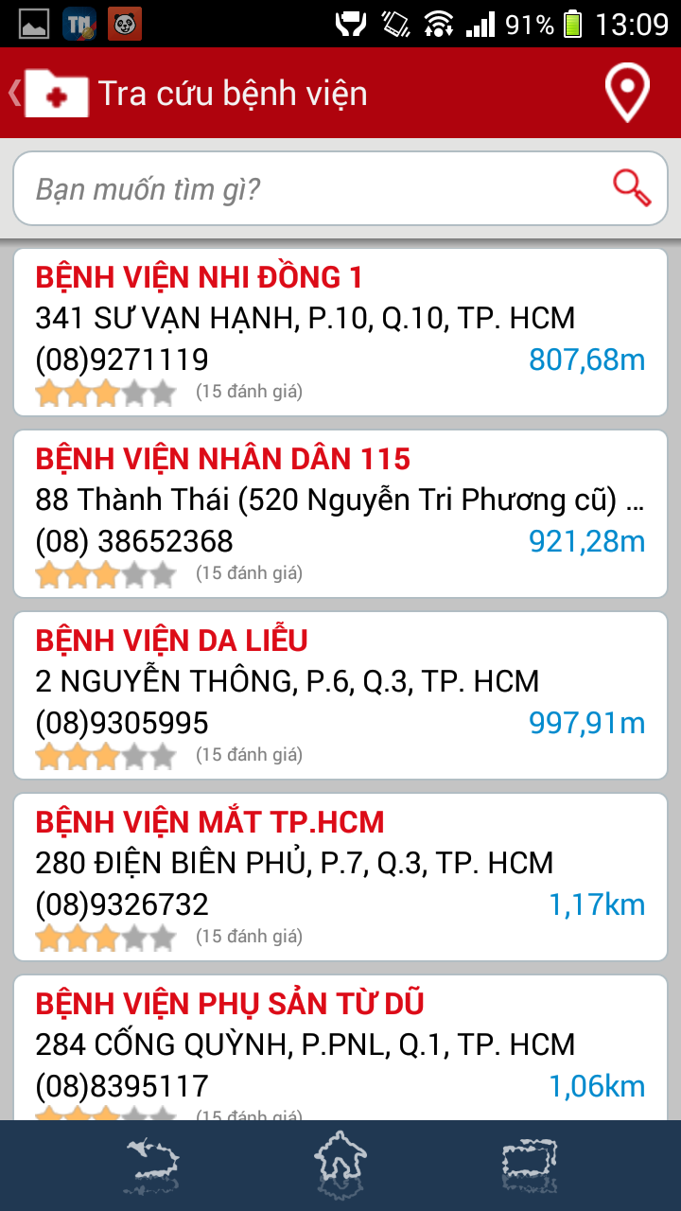

Slide 8
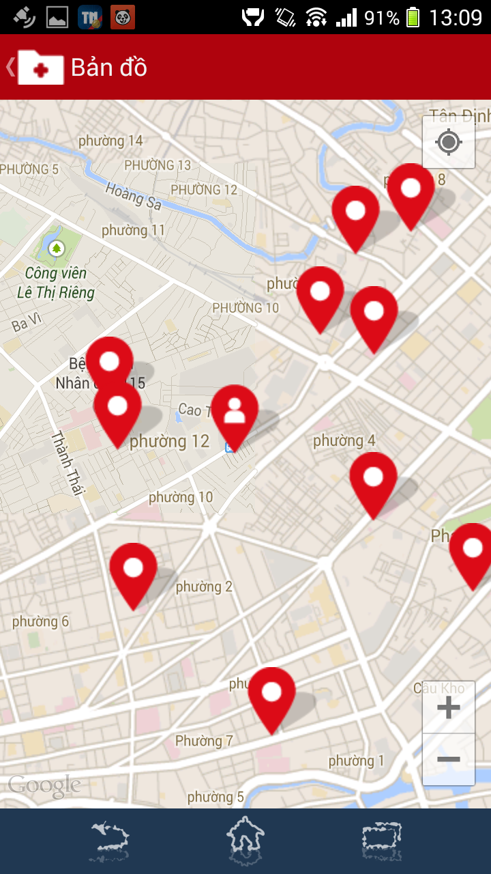

Slide 9
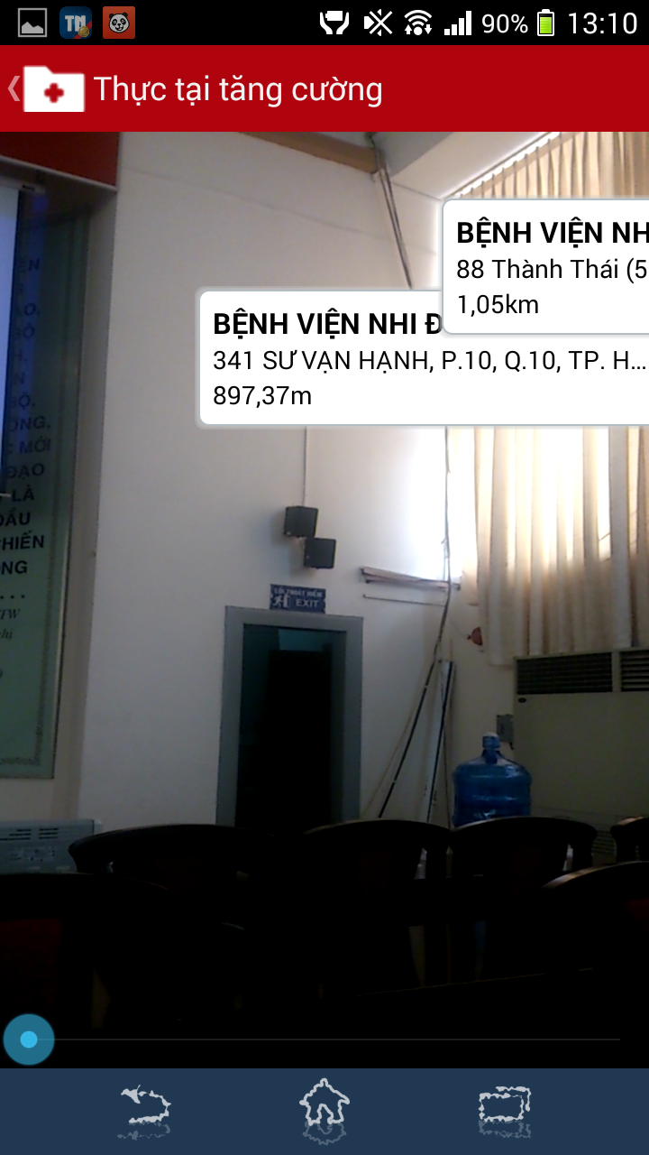

Slide 10
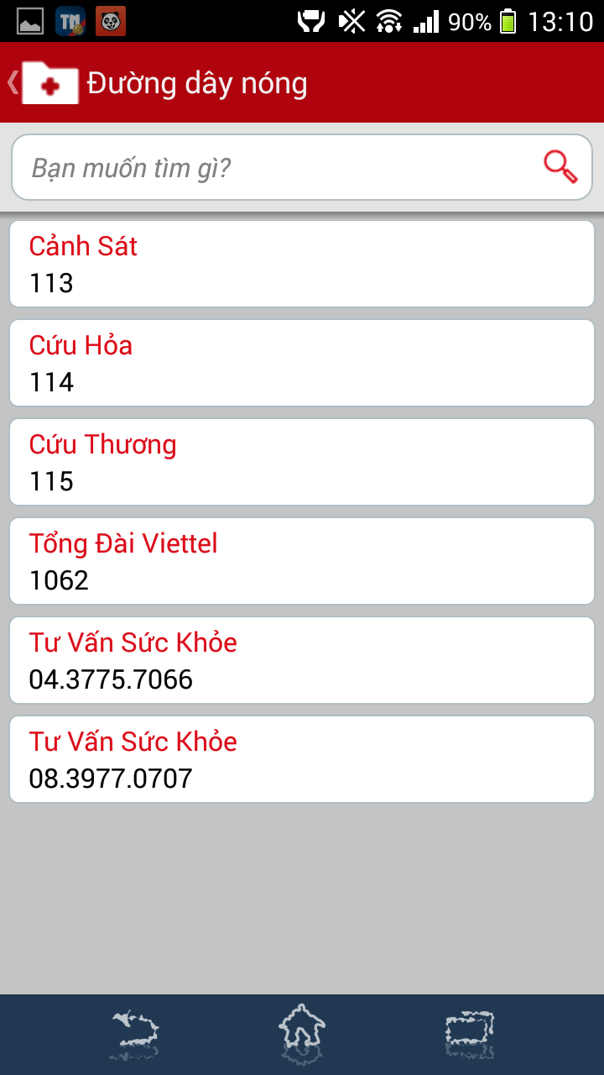

Slide 11
Our Vision
TaCare
Web + Mobile
News
Profiles
Care Packages
Online Health Consultant

Slide 12





Trần Thị Thuỳ Linh
Lake Forest College
Administrator, Innovator
Lê Hoàng Trung
University of Technology
Innovator
TaCare
Hồ Minh Nhật
Carleton University
Producer, Integrator
Nguyễn Công Chánh
University of Science
Producer
Nguyễn Thanh Xuân
University of Medicines and Pharmacy
Producer

Slide 13
Revenues
TaCare
Care Packages
Paid Version
Ads Network
Professional Online Health Consultant

Slide 14
Future Costs
TaCare
Licenses
Database
System
HR
Marketing
=>> Cost: around $25,500 USD

Slide 15
Marketing Strategies
TaCare
PR
Social Marketing
Ads Network

